Slide 1


Who Wants to
Be a Millionaire?
Notes:
Lifeline icons on the question slides are hyperlinks which will take you to the lifeline screen. To return to the game, you may right click on the screen, choose Go, Previously Viewed. This should return you to the question slide. Alternatively, left click as usual to return to the game board, then click on the highest number that has been previously selected (in gold to indicate a followed hyperlink).
To utilize the 50:50 option, the moderator may tell the contestant which two options to disregard or, use Control-P to change the mouse arrow to a pen. Draw a line through two incorrect responses, then use Control-A to change the pen back into an arrow and continue with the game.
Clicking on the action button on the phone handset image of the Phone a Friend lifeline slide will hyperlink to the Ask Jeeves web site where the participant may ask for help.

Slide 2



1,000,000
500,000
250,000
125,000
64,000
32,000
16,000
8,000
4,000
2,000
1,000
500
300
200
100

Slide 3


Click to return to question, Cont-P to switch to the pen, cross out two incorrect answers, then Cont-A to switch back to pointer.

Slide 4

Click to return to the question and poll the class

Slide 5

Click on link to Ask Jeeves, or click on this oval to return to question and ask a friend

Slide 6
What brand of motor bike is green
?
A. KAWASAKI
B. YAMAHA
C .SUZUKI
D. HONDA

Slide 7
A. Well done
Back to Board

Slide 8
What famous moto xer whent to waipahihi ?
A. Chad reed
B.Ryan villopoto
C. Ben townley
D. james stewart

Slide 9
C. Well done
Back to Board

Slide 10
what brand motor bike do I ride
?
A. ktm
B.kawasaki
C. Suzuki
d.yamaha

Slide 11
B. Well done
Back to Board

Slide 12
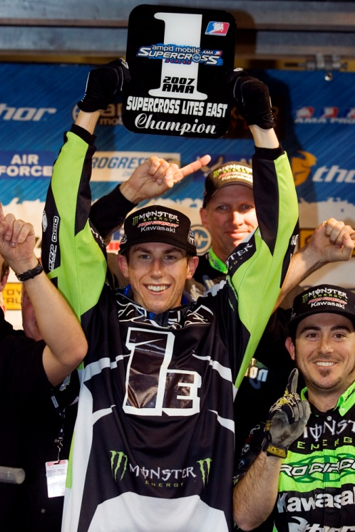
Who is this this?
A. Ben townley
B. Josh coppins
C. Chad reed
D. Blake gillard

Slide 13
A. Well done
Back to Board

Slide 14
What motor bike does ben townley
ride
A. Tm
B. ktm
C. Kawasaki
D. honda

Slide 15
D. Well done
Back to Board

Slide 16
What is my best position this sesson
A. 1st
B. 60th
C. 2nd
D.4th

Slide 17
C. Well done
Back to Board

Slide 18
Who trains me for moto x
A. cam dillon
B.lee mckinstry
C. blake gillard
D. nick saunders

Slide 19
B. Well done
Back to Board

Slide 20
A. Incorrect
B. incorrect
C. correct
D. incorrect

Slide 21
C. Well done
Back to Board

Slide 22
Who have been battling it out for fist place in super x
A.me and lee
B.andrew short and ronald
macdonald
Cam dillon and nick saunders
d. Chad reed and james stewart

Slide 23
D. Well done
Back to Board

Slide 24
What grade do ride in
A. 11 to 12s
B. 8 to 10s
C. 13 to 16s
D. 6 to 8s

Slide 25
B. Well done
Back to Board

Slide 26
What cc moto bike do I ride
A. 85 racing
B.85 farm
C. 50 cc
D. push bike

Slide 27
A. Well done
Back to Board

Slide 28
When did I start moto x
A. 7
B.5
C. 8
D. 6

Slide 29
B. Well done
Back to Board

Slide 30
What is the name of the taupo moto x track
A.the moto x track
B. pumis pit
C. digger mcquen
D.red woods

Slide 31
C. Well done
Back to Board

Slide 32
How old is lee mckinstry
A. 22
B. 24
C. 16
D. 19

Slide 33
D. well done
Back to Board

Slide 34
Whats the biggest jump at taupo
Moto x track
A. energy center point
B.dam
C.site care
D.spetro

Slide 35
A. Great u did awsome

Slide 36
Sorry, try again!

Slide 37
Thanks for playing!

